Slide 1
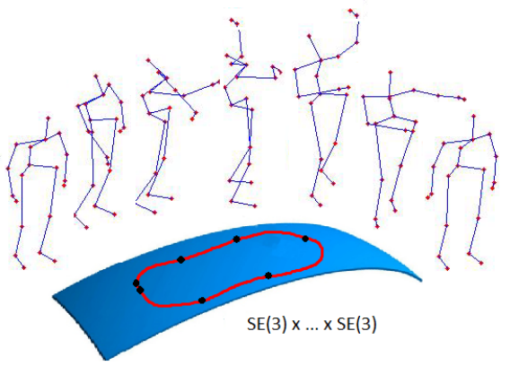
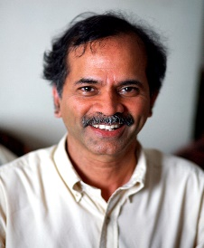
Human Action Recognition by Representing 3D Skeletons as Points in a Lie Group
Raviteja Vemulapalli
University of Maryland, College Park.
Professor Rama Chellappa
Dr. Felipe Arrate

Slide 2
Action Recognition from 3D Skeletal Data
Motivation: Humans can recognize many actions directly from skeletal sequences.
Tennis serve
Jogging
Sit down
Boxing
But, how do we get the 3D skeletal data?

Slide 3
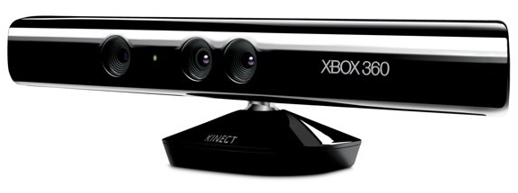
Cost Effective Depth Sensors
Human performing an action
Cost effective depth sensors like Kinect
State-of-the-art depth-based skeleton estimation algorithm [Shotton 2011]
Real-time
skeletal sequence
UTKinect-Action dataset [Xia2012]
J. Shotton, A. Fitzgibbon, M. Cook, T. Sharp, M. Finocchio, R. Moore, A. Kipman and A. Blake, "Real-time Human Pose Recognition in Parts From a Single Depth Image", In CVPR, 2011.
L. Xia, C. C. Chen and J. K. Aggarwal, "View Invariant Human Action Recognition using Histograms of 3D Joints ", In CVPRW, 2012.

Slide 4
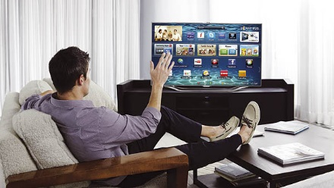
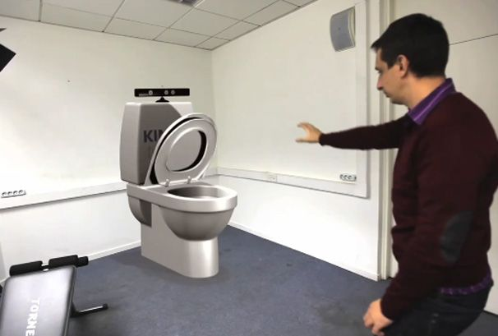
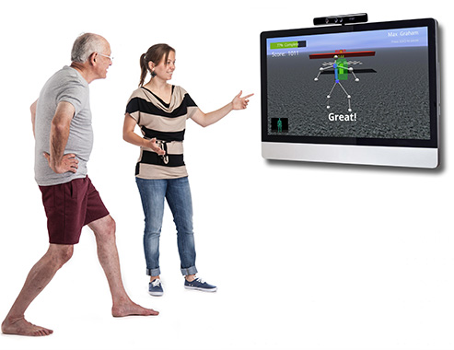
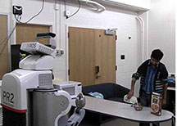
Applications
Gesture-based Control
Elderly Care
Teaching Robots

Slide 5
Skeleton-based Action Recognition
Sequence
of skeletons
Skeletal Representation
Joint positions, Joint angles, etc.
Temporal Modeling
HMM, DTW, Fourier analysis, etc.
Classification
Bayes classifier, NN, SVM, etc.
Action
label
Overview of a typical skeleton-based action recognition approach.

Slide 6
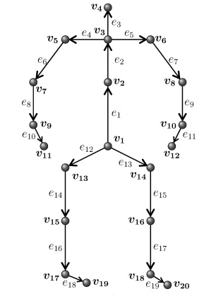
How to represent a 3D human skeleton for action recognition ?

Slide 7
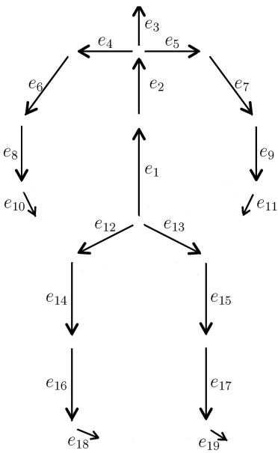
Human Skeleton: Points or Rigid Rods?
Set of points
(joints)
Set of rigid rods
(body parts)

Slide 8
Human Skeleton as a Set of Points
Inspired by the moving lights display experiment by [Johansson 1973].
Popularly-used skeletal representation.
Representation:
Concatenation of the 3D coordinates of the joints.
G. Johansson, “Visual Perception of Biological Motion and a Model for its Analysis", Perception and Psychophysics, 1973.

Slide 9
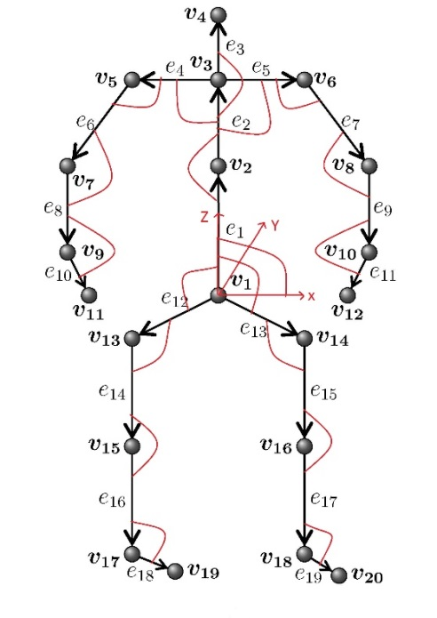
Human Skeleton as a Set of Rigid Rods
Human skeleton is a set of 3D rigid rods (body parts) connected by joints.
Spatial configuration of these rods can be represented using joint angles (shown using red arcs in the below figure).
Representation:
Concatenation of the Euler angles or Axis-angle or quaternion representations corresponding to the 3D joint angles.

Slide 10
Proposed Representation: Motivation
Human actions are characterized by how different body parts move relative to each other.
For action recognition, we need a skeletal representation whose temporal evolution directly describes the relative motion between various body parts.

Slide 11
Proposed Skeletal Representation
We represent a skeleton using the relative 3D geometry between different body parts.
The relative geometry between two body parts can be described using the 3D rotation and translation required to take one body part to the position and orientation of the other.

Slide 12
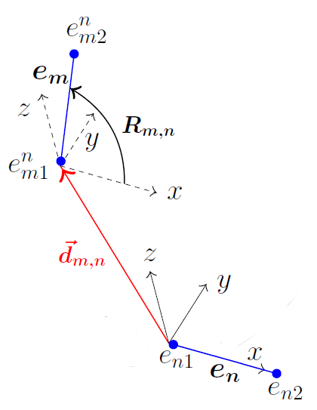
Relative 3D Geometry between Body Parts
We describe the relative geometry between two rigid body parts $(e_{m}, e_{n})$at time instance t using the rotation $R_{m,n}(t)$ and the translation ${\vec{d}}_{m,n}(t)$ (measured in the local coordinate system attached to $e_{n}$) required to take $e_{n}$ to the position and orientation of $e_{m}$.
$\left[\begin{matrix}e_{m1}^{n}(t) & e_{m2}^{n}(t) \\ 1 & 1\end{matrix}\right]=\left[\begin{matrix}R_{m,n}(t) & {\vec{d}}_{m,n}(t) \\ 0 & 1\end{matrix}\right]$ $\left[\begin{matrix}e_{n1}(t) & {s_{m,n}∗e}_{n2}(t) \\ 1 & 1\end{matrix}\right]$
Rotation and translation vary with time.
Scaling factor: Independent of
time since lengths of the body parts do not change with time.

Slide 13
R. M. Murray, Z. Li, and S. S. Sastry, "A Mathematical Introduction to Robotic Manipulation", CRC Press, 1994.

Slide 14
Special Euclidean Group SE(3)
The special Euclidean group, denoted by SE(3), is the set of all $4×4$ matrices of the form
$P\left(R, \vec{d}\right)= \left[\begin{matrix}R & \vec{d} \\ 0 & 1\end{matrix}\right]$,
where $\vec{d}∈R^{3}$ and R is a $3×3$ rotation matrix.
The group SE(3) is a smooth 6-dimensional curved manifold.
The tangent plane to the manifold SE(3) at the identity matrix $I_{4}$, denoted by se(3), is known as the Lie algebra of SE(3).
Lie algebra se(3) is a 6-dimensional vector space.
The exponential map $\exp_{SE(3)}:\text{se}\text{(3)}→SE(3)$ and the logarithm map $\log_{SE(3)}:SE(3)→\text{se}\text{(3)}$ are given by
$\exp_{SE\left(3\right)}\left(B\right)= e^{B}$,
$\log_{SE\left(3\right)}\left(P\right)=log⁡(P)$,
where e and log denote the usual matrix exponential and logarithm.

Slide 15
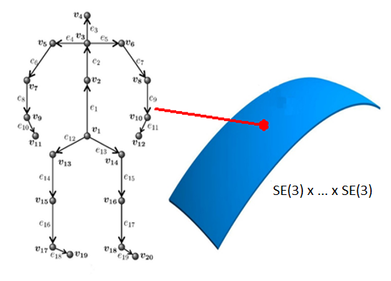
Proposed Skeletal Representation
Human skeleton is described using the relative 3D geometry between all pairs of body parts.
$$\left\{P_{m,n}(t)=\left[\begin{matrix}R_{m,n}(t) & {\vec{d}}_{m,n}(t) \\ 0 & 1\end{matrix}\right]: m≠n, 1≤m,n≤19\right\}∈ SE\left(3\right)×…×SE\left(3\right).$$
Point in SE(3) describing the relative 3D geometry between body parts (e_{m} , e_{n}) at time instance t.
Lie group obtained by combining multiple SE(3) using the direct product $×$.

Slide 16
Proposed Action Representation
Using the proposed skeletal representation, a skeletal sequence can be represented as a curve in the Lie group$SE\left(3\right)×…×SE\left(3\right):$
$\left\{ \left\{{ P}_{m,n}\left(t\right) | m≠n, 1≤m,n≤19\right\} , t∈[0, T] \right\}$.
Point in SE(3)$×… ×$ SE(3) representing the skeleton at time instance t.

Slide 17
Proposed Action Representation
Classification of the curves in $SE\left(3\right)×…×SE(3)$into different action categories is a difficult task due to the non-Euclidean nature of the space.
Standard classification approaches like support vector machines (SVM) and temporal modeling approaches like Fourier analysis are not directly applicable to this space.
To overcome these difficulties, we map the curves from the Lie group $SE\left(3\right)×…×SE(3)$to its Lie algebra se(3) $×… ×$ se(3), which is a vector space.

Slide 18
Proposed Action Representation
Human actions are represented as curves in the Lie algebra $\text{se}\text{(3) }×… × \text{se}\text{(3)}$.
$\left\{ \left\{ {\log_{SE\left(3\right)}( P}_{m,n}\left(t\right) ) | m≠n, 1≤m,n≤19\right\} , t∈[0, T] \right\}$.
Action recognition can be performed by classifying the curves in the vector space $\text{se}\text{(3) }×… × \text{se}\text{(3)}$ into different action categories.
Point in se(3)$×… ×\text{se}\text{(3)}$ representing
the skeleton at time instance t.
Point in SE(3) describing the relative 3D geometry
between body parts (e_{m} , e_{n}) at time instance t.
Point in se(3)

Slide 19
Temporal Modeling and Classification
Action classification is a difficult task due to various issues like rate variations, temporal misalignments, noise, etc.
Following [Veeraraghavan 2009], we use Dynamic Time Warping (DTW) to handle rate variations.
Following [Wang 2012], we use the Fourier temporal pyramid (FTP) representation to handle noise and temporal misalignments.
We use linear SVM with Fourier temporal pyramid representation for final classification.
Curve in
$\text{se}\text{(3) }×… × \text{se}\text{(3)}$
Dynamic Time Warping
Fourier Temporal Pyramid Representation
Linear SVM
Action
label
A. Veeraraghavan, A. Srivastava, A. K. Roy-Chowdhury and R. Chellappa, "Rate-invariant Recognition of Humans and Their
Activities", IEEE Trans. on Image Processing, 18(6):1326–1339, 2009.
J. Wang, Z. Liu, Y. Wu and J. Yuan, "Mining Actionlet Ensemble for Action Recognition with Depth Cameras", In CVPR, 2012.

Slide 20
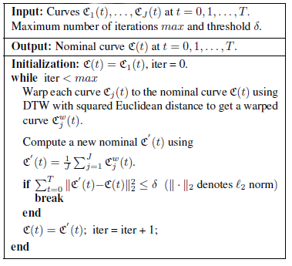
Computation of Nominal Curves using DTW
We interpolate all the curves in the Lie group $SE\left(3\right)×…×SE(3)$to have same length.

Slide 21
Fourier Temporal Pyramid Representation
Fourier Transform
Fourier Transform
Level 0
Fourier Transform
Fourier Transform
Level 1
Fourier Transform
Fourier Transform
Level 2
Fourier Transform
Magnitude of the low frequency Fourier coefficients from each level are used to represent a time sequence.
J. Wang, Z. Liu, Y. Wu and J. Yuan, "Mining Actionlet Ensemble for Action Recognition with Depth Cameras", In CVPR, 2012.

Slide 22
Overview of the Proposed Approach

Slide 23
Experiments: Datasets
MSR-Action3D dataset
Total 557 action sequences
20 actions
10 subjects
W. Li, Z. Zhang, and Z. Liu, "Action Recognition Based on a Bag of 3D Points", In CVPR Workshops, 2010.
UTKinect-Action dataset
Total 199 action sequences
10 actions
10 subjects
L. Xia, C. C. Chen, and J. K. Aggarwal, "View Invariant Human Action Recognition Using Histograms of 3D Joints", In CVPR Workshops, 2012.
Florence3D-Action dataset
Total 215 action sequences
9 actions
10 subjects
L. Seidenari, V. Varano, S. Berretti, A. D. Bimbo, and P. Pala, "Recognizing Actions from Depth Cameras as Weakly Aligned Multi-part Bag-of-Poses", In CVPR Workshops, 2013.

Slide 24
Alternative Representations for Comparison
Joint positions (JP):
Concatenation of the 3D coordinates of the joints.
Joint angles (JA):
Concatenation of the quaternions corresponding to the joint angles (shown using red arcs in the figure).
Pairwise relative positions of the joints (RJP):
Concatenation of the 3D vectors $\vec{v_{i }v_{j}}, 1 ≤i <j≤20.$
Individual body part locations(BPL):
Each body part $e_{m}$ is represented as a point in $SE(3)$ using its relative 3D geometry with respect to the global $x$-axis.

Slide 25
MSR-Action3D Dataset
Total 557 action sequences: 20 actions performed (2 or 3 times) by 10 different subjects.
Dataset is further divided into 3 subsets: AS1, AS2 and AS3.
Action Set 1 (AS1) | Action Set 2 (AS2) | Action Set 3 (AS3)
Horizontal arm wave Hammer Forward punch High throw Hand clap Bend Tennis serve Pickup & throw | High arm wave Hand catch Draw x Draw tick Draw circle Two hand wave Forward kick Side boxing | High throw Forward kick Side kick Jogging Tennis swing Tennis serve Golf swing Pickup & throw

Slide 26
Results: MSR-Action3D Dataset
Experiments performed on each of the subsets (AS1, AS2 and AS3) separately.
Half of the subjects were used for training and the other half were used for testing.
Dataset | JP | RJP | JA | BPL | Proposed
AS1 | 91.65 | 92.15 | 85.80 | 83.87 | 95.29
AS2 | 75.36 | 79.24 | 65.47 | 75.23 | 83.87
AS3 | 94.64 | 93.31 | 94.22 | 91.54 | 98.22
Average | 87.22 | 88.23 | 81.83 | 83.54 | 92.46
Approach | Accuracy
Eigen Joints | 82.30
Joint angle similarities | 83.53
Spatial and temporal part-sets | 90.22
Covariance descriptors on 3D joint locations | 90.53
Random forests | 90.90
Proposed approach | 92.46
Recognition rates for various skeletal representations on MSR-Action3D dataset.
Comparison with the state-of-the-art results on MSR-Action3D dataset.

Slide 27
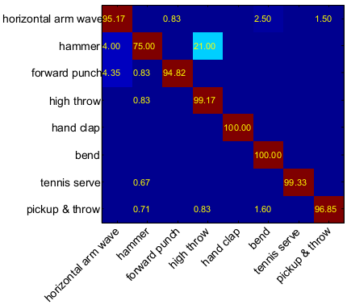
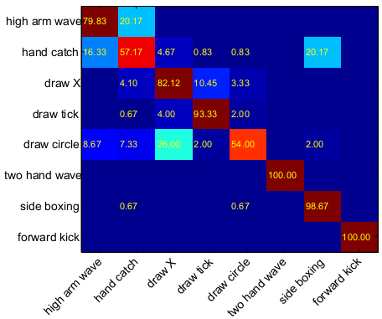
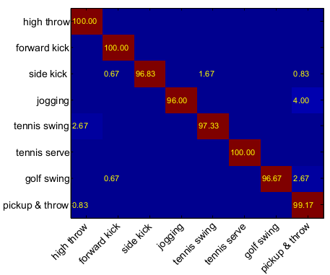
MSR-Action3D Confusion Matrices
Action set 1 (AS1)
Action set 2 (AS2)
Action set 3 (AS3)
Average recognition accuracy: 95.29%
Average recognition accuracy: 83.87%
Average recognition accuracy: 98.22%

Slide 28
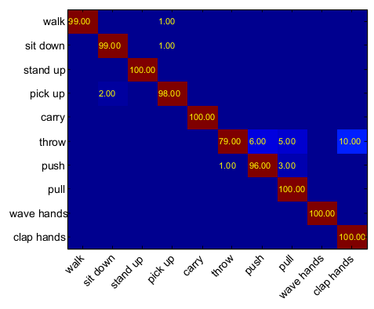
Results: UTKinect-Action Dataset
Total 199 action sequences: 10 actions performed (2 times) by 10 different subjects.
Half of the subjects were used for training and the other half were used for testing.
JP | RJP | JA | BPL | Proposed
94.68 | 95.58 | 94.07 | 94.57 | 97.08
Recognition rates for various skeletal representations on UTKinect-Action dataset.
Approach | Accuracy
Random forests | 87.90
Histograms of 3D joints | 90.92
Proposed approach | 97.08
Comparison with the state-of-the-art results on UTKinect-Action dataset.

Slide 29
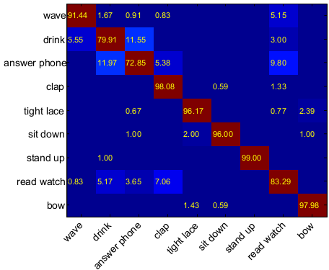
Results: Florence3D-Action Dataset
Total 215 action sequences: 9 actions performed (2 or 3 times) by 10 different subjects.
Half of the subjects were used for training and the other half were used for testing.
JP | RJP | JA | BPL | Proposed
85.26 | 85.2 | 81.36 | 80.80 | 90.88
Recognition rates for various skeletal representations on Florence3D-Action dataset.
Approach | Accuracy
Multi-Part Bag-of-Poses | 82.00
Proposed approach | 90.88
Comparison with the state-of-the-art results on Florence3D-Action dataset.

Slide 30
Thank You

